Slide 1
Modeling Selectivity in Stock Synthesis

Slide 2
Selectivity in SS
Parametric and Non-Parametric options
Semi-Parametric option under development
Selectivity can be a function of age and/or length
Parameters of the selectivity curves have all the functionality as other parameters:
time blocks, random variation, covariates, priors, etc.

Slide 3
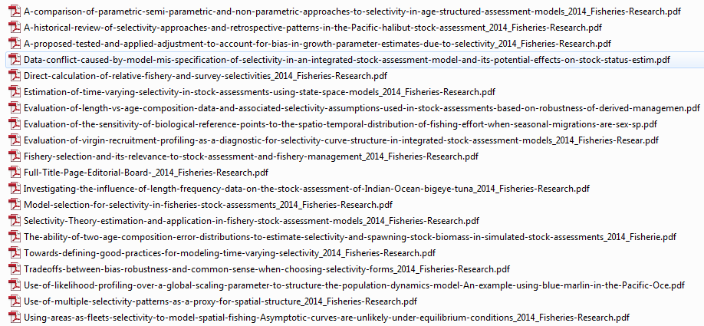
CAPAM Workshop - 2013

Slide 4
Functional forms
Full selectivity for selected range of ages or lengths
Logistic
commonly used for asymptotic selectivity
Double normal
most commonly used selectivity, allows a declining right limb
Exponential-logistic
Piecewise linear (in log space) function of length
One value per age
Random walk across ages
Selex override: spawning biomass, recruitment, or rec dev
Mirror selectivity of another fleet/survey

Slide 5
Double normal
Comprised of the outer sides of two adjacent normal curves with separate variance parameters and peaks joined by a horizontal line.
The parameters include
the selectivity at the smallest and largest ages/sizes,
the age/size where the selectivity first reaches full selectivity,
the length of the plateau, and
two parameters controlling the slope of the ascending and descending limbs.
Can be made asymptotic by fixing some parameters
Options for parameters representing selectivity at smallest and largest ages/sizes:
use, ignore, or ignore and make selectivity constant below/above specified bin

Slide 6
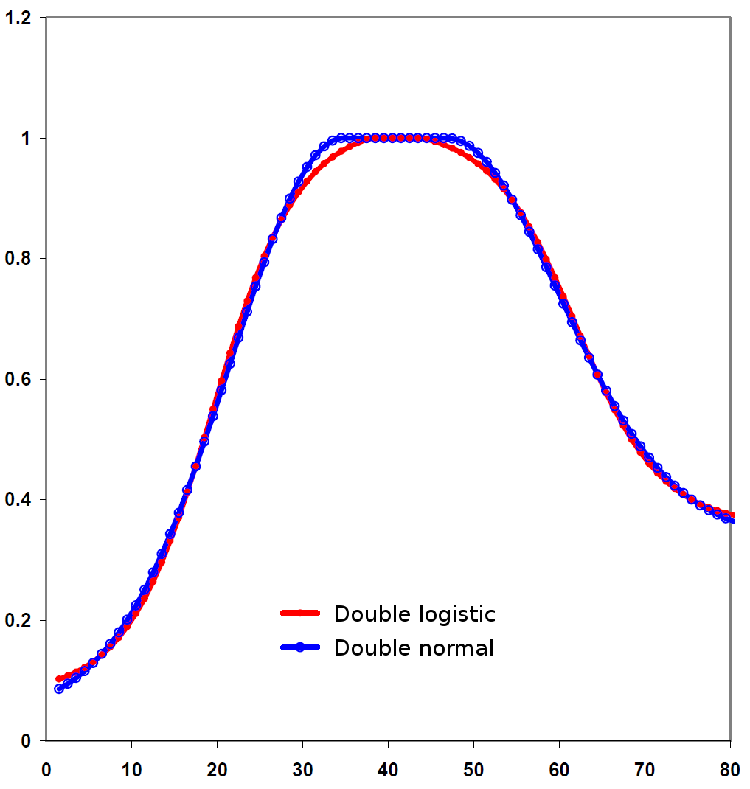
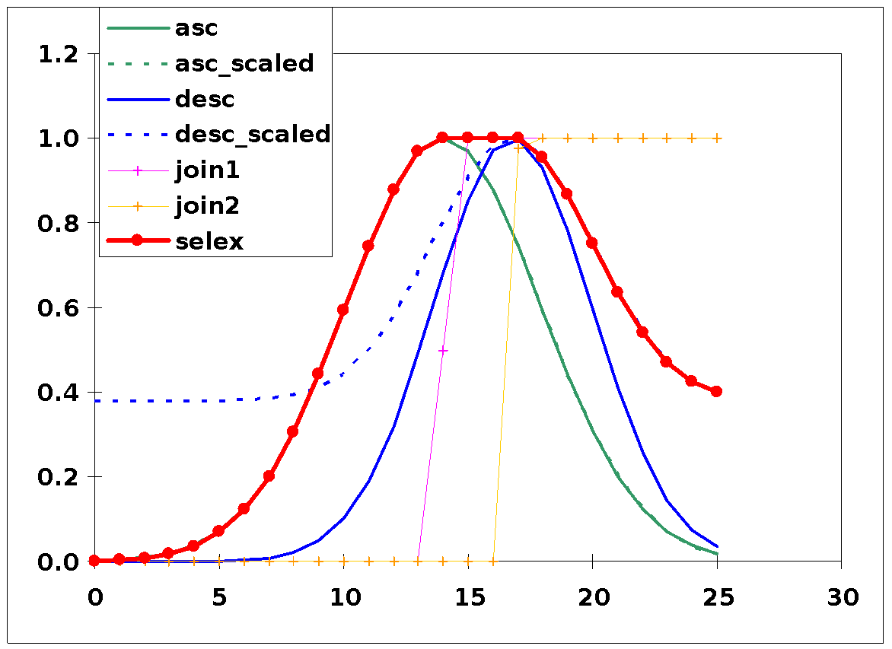
Double normal

Slide 7
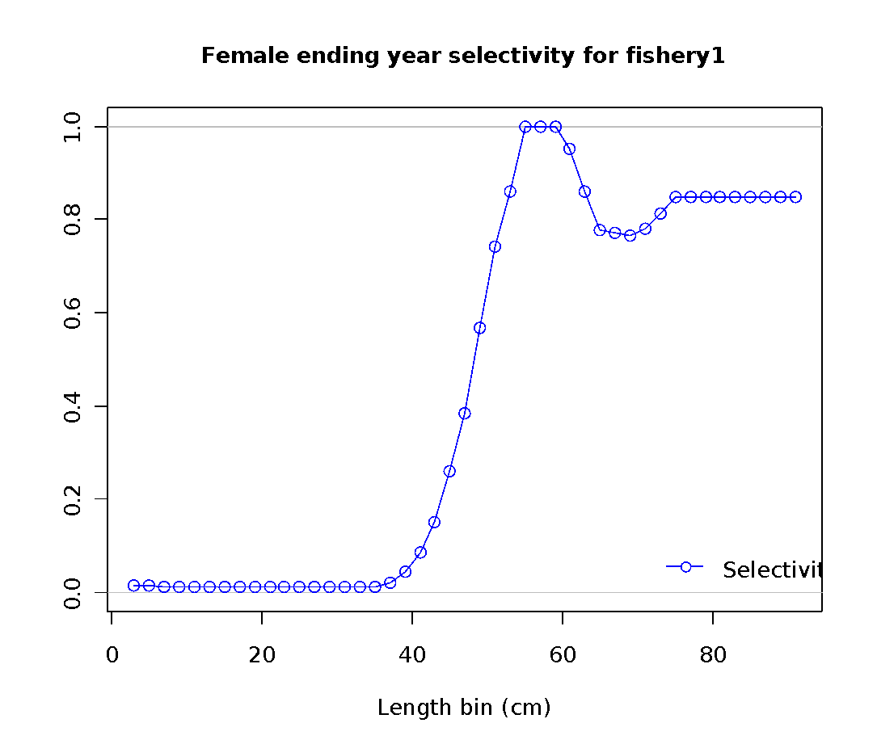
Piecewise, log-linear length selectivity (#6)
exp(interpolated value_{L} – max(I.V.))

Slide 8
Pattern 17 (age)
This selectivity pattern provides for a random walk in ln(selectivity). In typical
usage:
First parameter (for age 0) could have a value of -1000 so that the age 0 fish would get a selectivity of 0.0;
Second parameter (for age 1) could have a value of 0.0 and not be estimated, so age 1 is the reference age against which subsequent changes occur;
Next parameters get estimated values. To assure that selectivity increases for the
younger ages, the parameter min for these parameters could be set to 0.0 or a slightly negative value.
If dome-shaped selectivity is expected, then the parameters for older ages could have a range with the max set to 0.0 so they cannot increase further.
To keep selectivity at a particular age the same as selectivity at the next younger age, set its parameter value to 0.0 and not estimated. This allows for all older ages to have the same selectivity.
To keep a constant rate of change in selectivity across a range of ages, use the - 999 flag to keep the same rate of change in ln(selectivity) as for the previous age.

Slide 9
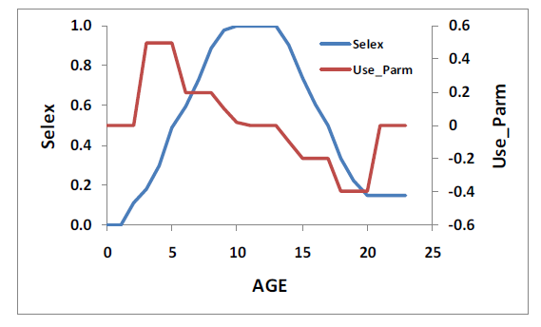
Random walk age selectivity

Slide 10
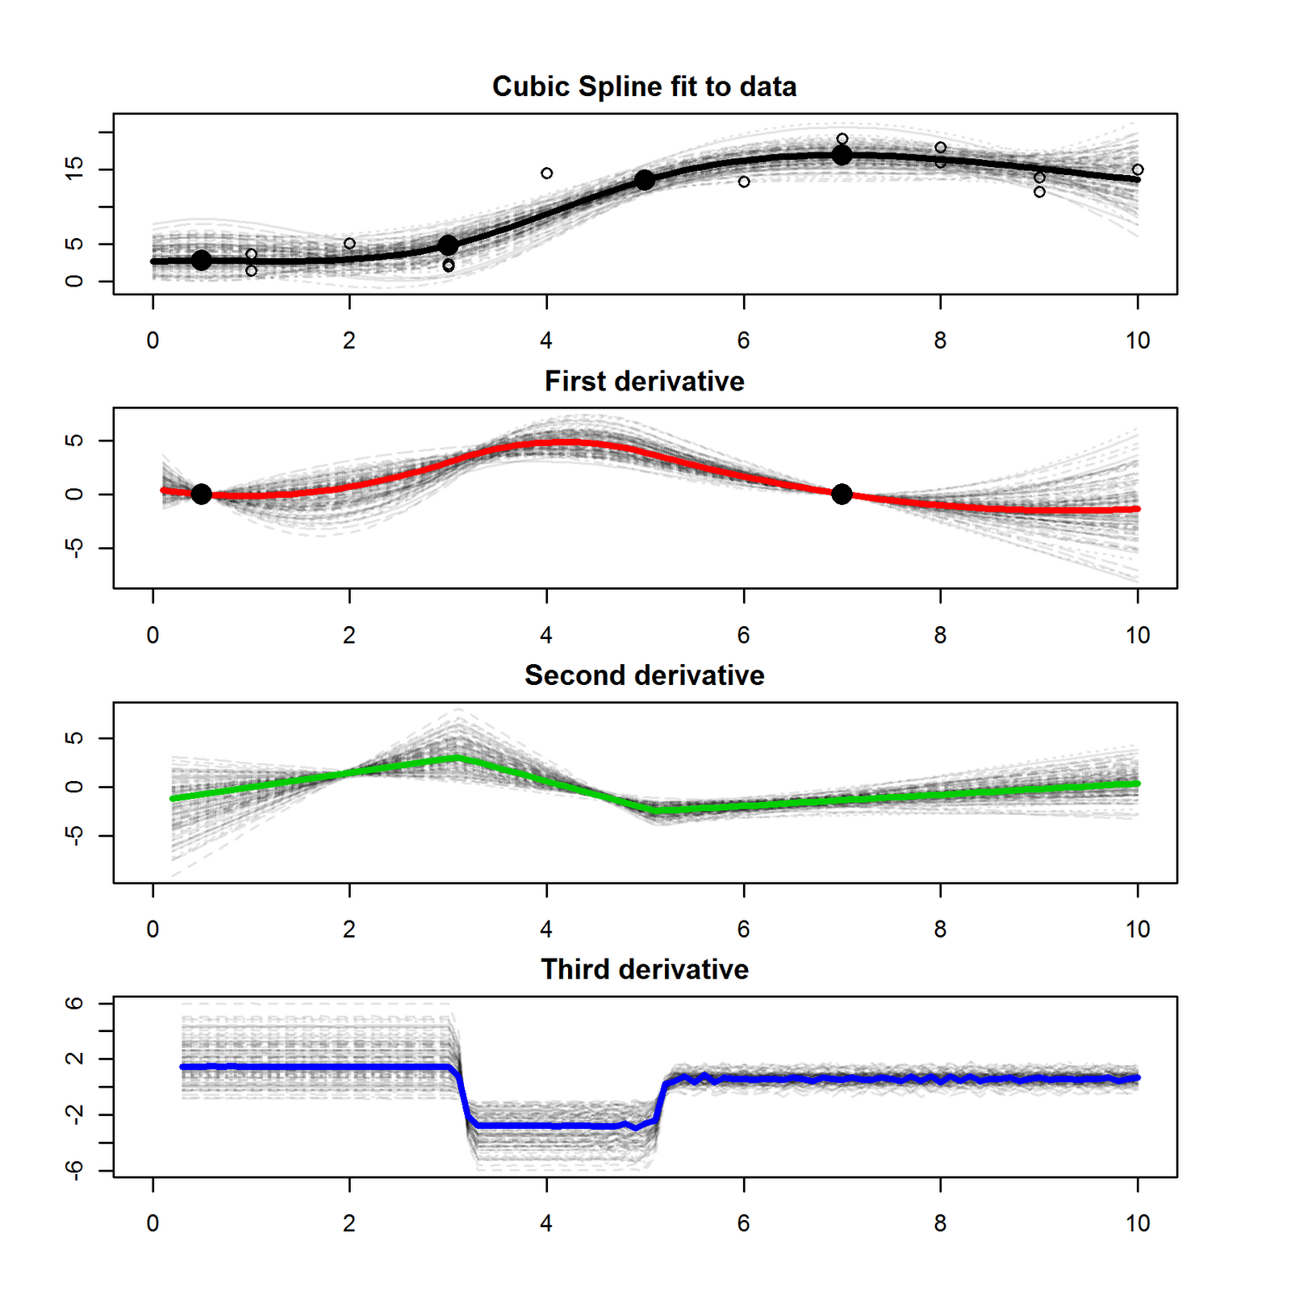
Understanding splines in ADMB

Slide 11
Exploring splines
R function “selfit_spline” based on work of Tommy Garrison:
library(r4ss) update_r4ss_files()
selfit_spline(n=4, dir='c:/test/')
Could not replicate ADMB’s spline calculations in R late on Friday afternoon.
But there’s a better way…

Slide 12
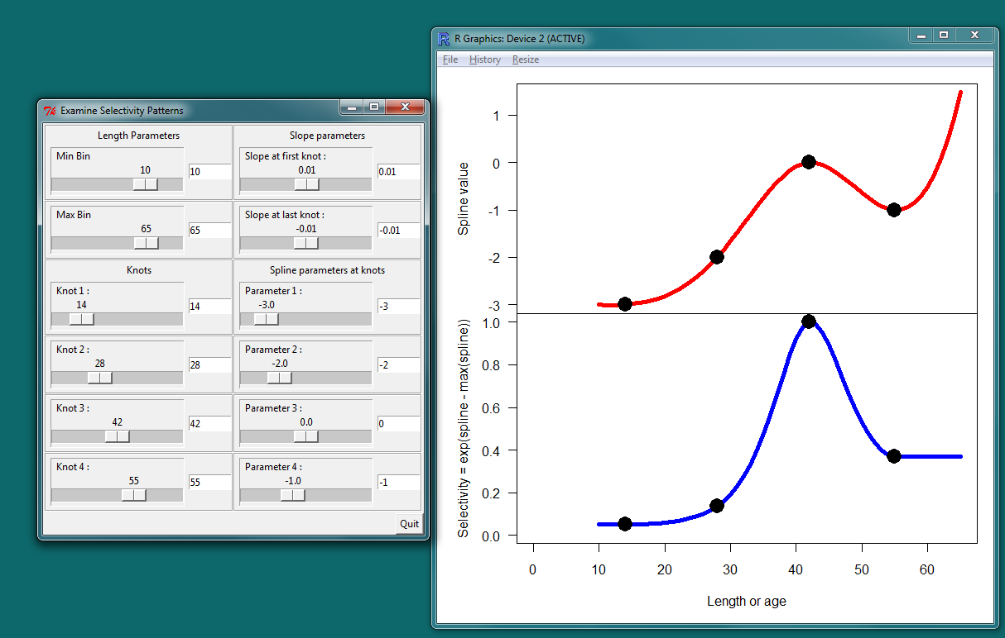
Run example

Slide 13
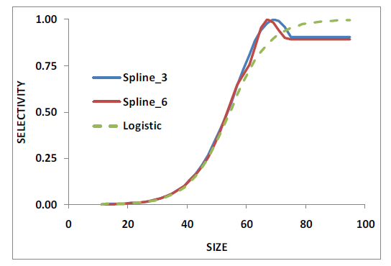
Compare Splines

Slide 14
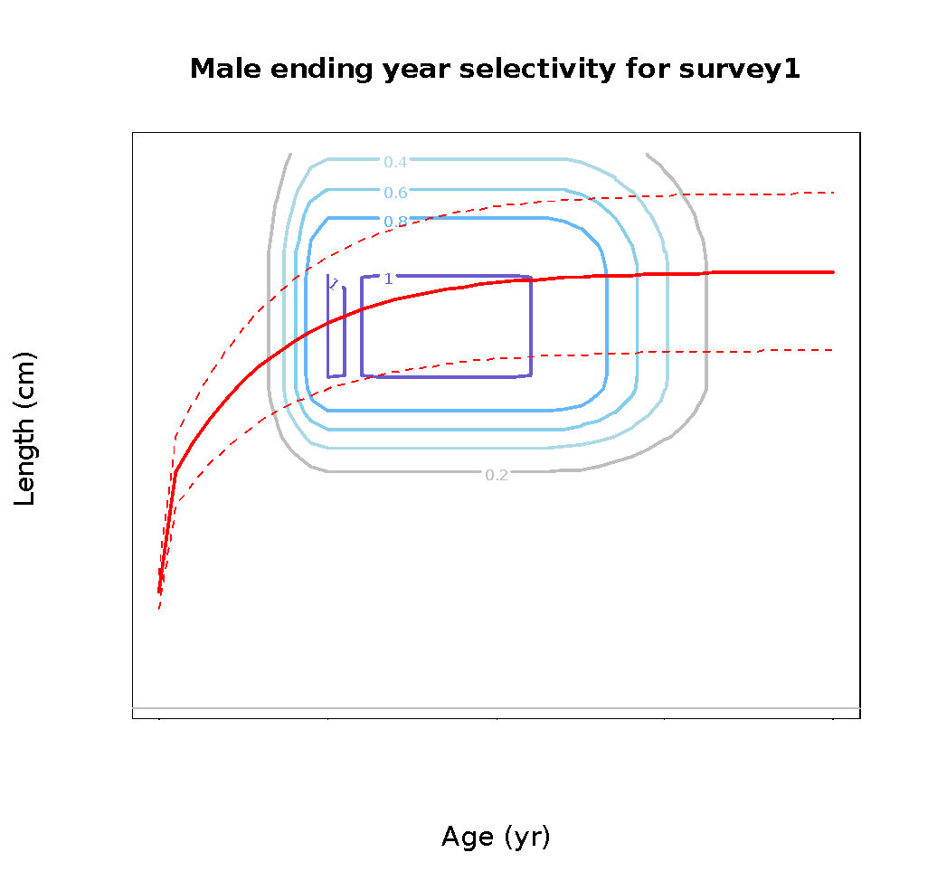
Combining selectivity at length at age
Independent functions
Example with two double normals:
growth curve

Slide 15
Male offset
Male (or female) selectivity is modeled two ways
1. Offset from female selectivity using a broken stick with parameters:
age/size at the break point
log( male / female selectivity ) at min, max, and break point
2. A function of parameters which are computed as offsets from parameters for other gender (only available for logistic and double normal)

Slide 16
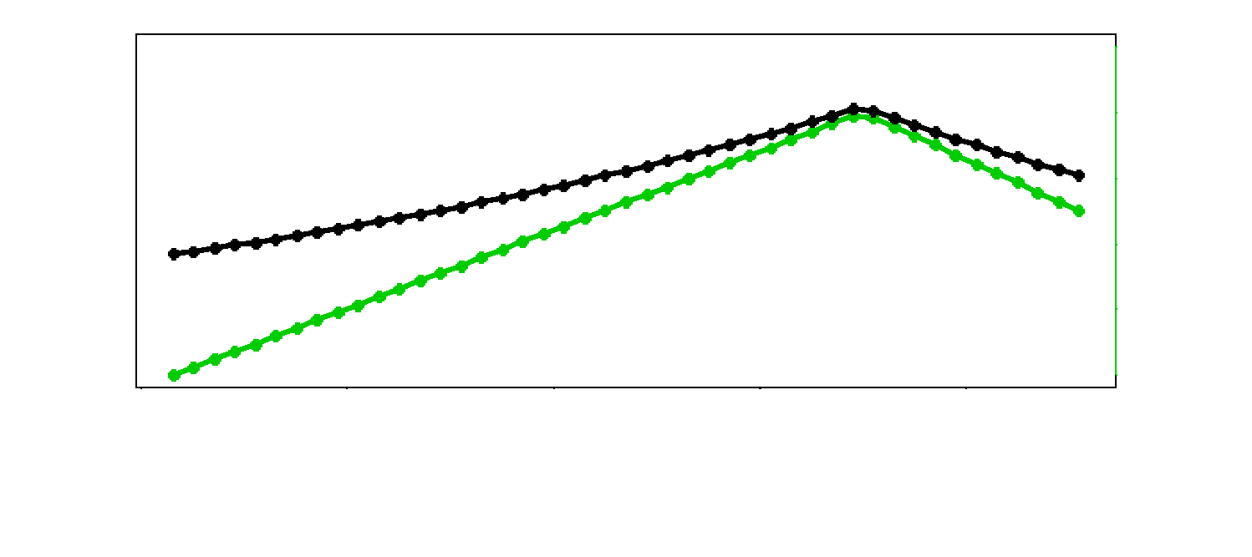
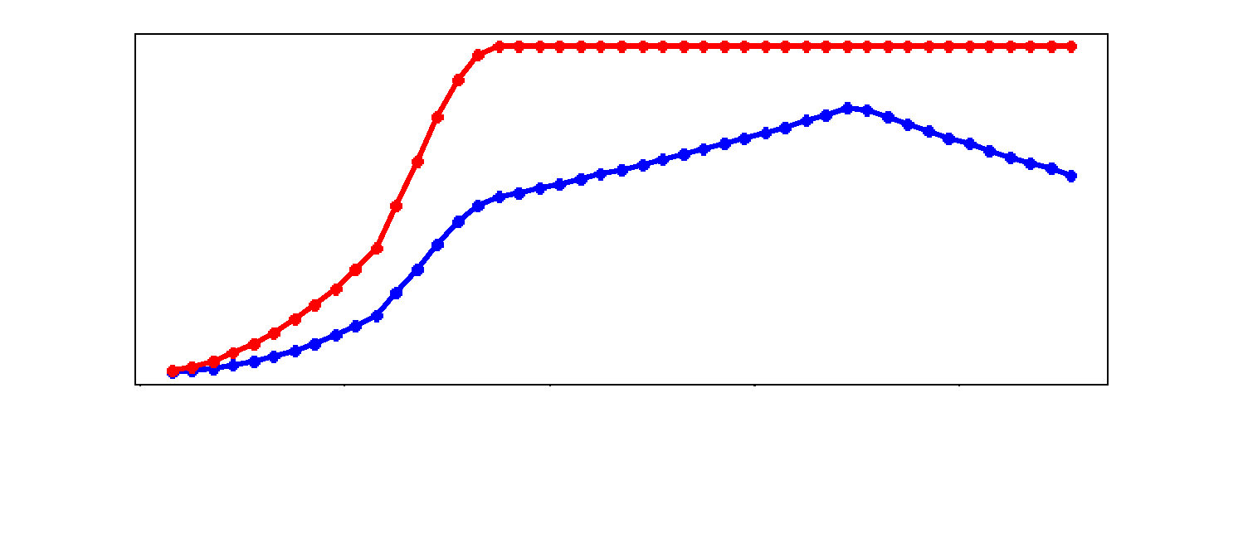
Male offset

